Slide 1

ARyas!! Augmented Reality for a Better future
TEAM: BRUTE FORCE

Slide 2
TABLE OF CONTENTS:
01
02
03
OUR SOLUTION
CURRENT STATUS
PROBLEM STATEMENT

Slide 3
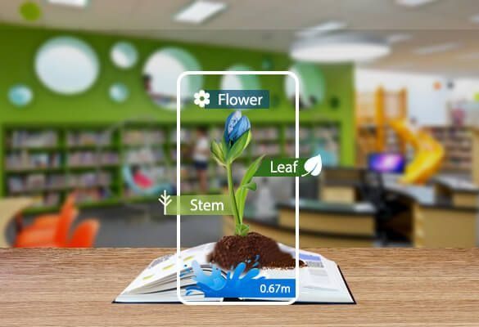

PROBLEM STATEMENT:
Creating an augmented reality-based application for making learning
easy and fun.

Slide 4
INTRODUCTION:
The AR experience is thriving as a key trend, with estimates that 2.4 billion Augmented Reality mobile users will exist by 2023. In 2015, however, there were barely 200 million users. It's a fantastic increase in numbers that can't be overlooked. However, the use of Augmented Reality in education and eLearning applications piques our curiosity. Many of us are only familiar with Augmented Reality from smartphone games such as Pokémon Go and social media sites such as Snapchat. Education, on the other hand, is another important area where modern technology has the potential to blow out the candles.

Slide 5
With AR, classroom education can be extraordinary and more interactive, as AR can enable teachers to show virtual examples of concepts and add gaming elements to provide textbook material support. This will enable students to learn faster and memorize information.

Slide 6
HUMAN MEMORY DOESN'T FORGET VISUALS EASILY. HERE ARE SOME EXAMPLES OF AUGMENTED REALITY IN EDUCATION:
An AR app, called "Dinosaur 4D+," with a set of flashcards enables users to view 3D dinosaurs, scanning through the card. With this, students can see the actions of dinosaurs and use app features to rotate, zoom, and more. Besides, the application also provides some information about each dinosaur.
The "Element 4D" AR app is another promising example of Augmented Reality in education, which makes learning chemistry fun. The application enables users to find the atomic weight, chemical elements, the reaction between two chemicals, and their names by simply putting two paper cubes for a special element block. Isn't it amazing?
Another admired example of AR/VR in education is Google Expeditions, which enables users to see 3D objects in the classroom, such as volcanoes, storms, and even DNA. This application provides more than 100 AR expeditions that include the history of technology, the moon landing, and more.

Slide 7
OUR SOLUTION:
Using our application, students can view their 2-D images in the textbooks as 3-D objects in Augmented Reality. We're creating 3-D objects for subjects like Biology, Chemistry, EVS, Physics, etc. By doing this they can get a better view of the 2-D objects and can understand theoretical concepts better. We are using software like Unity, echo3D, Paint 3D, and Blender.

Slide 8




OUR SOLUTION:
Unity
echo3D
Blender
Paint 3D
Unity is a cross-platform game engine developed by Unity Technologies. The engine can be used to create three-dimensional (3D) and two-dimensional (2D) games, as well as interactive simulations and other experiences.
echo3D is redefining how people create 3D, augmented reality (AR), and virtual reality (VR) experiences. It makes it simple for developers and content creators to build, manage and deploy 3D applications and content with our flexible cloud infrastructure.
Blender is a free and open-source 3D computer graphics software tool set used for creating animated films, visual effects, art, 3D printed models, motion graphics, interactive 3D applications, virtual reality, and computer games.
Paint 3D is a faster graphics and 3D modelling application which is a refresh of Microsoft Paint.

Slide 9
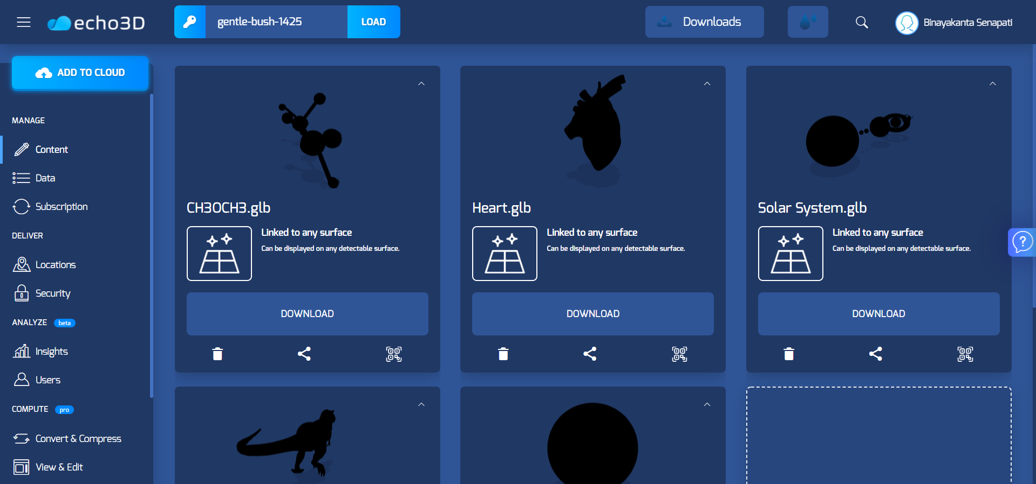
echo3D CLOUD

Slide 10
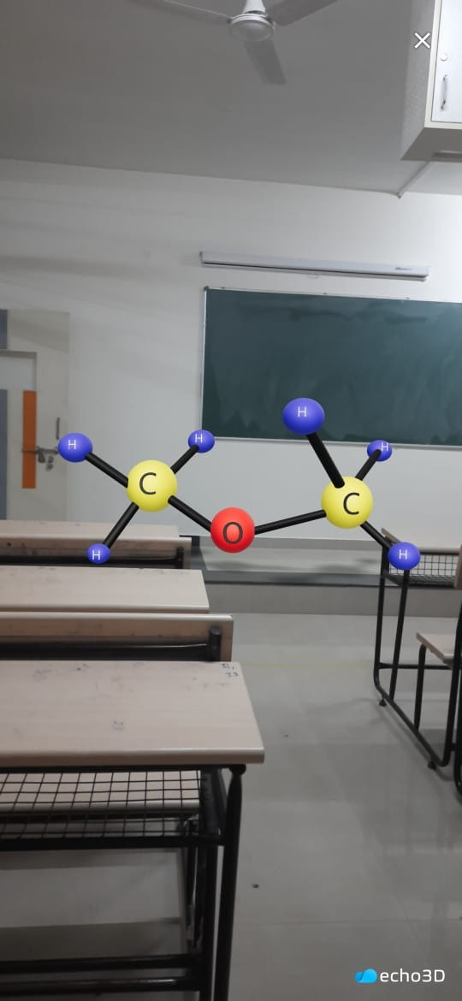
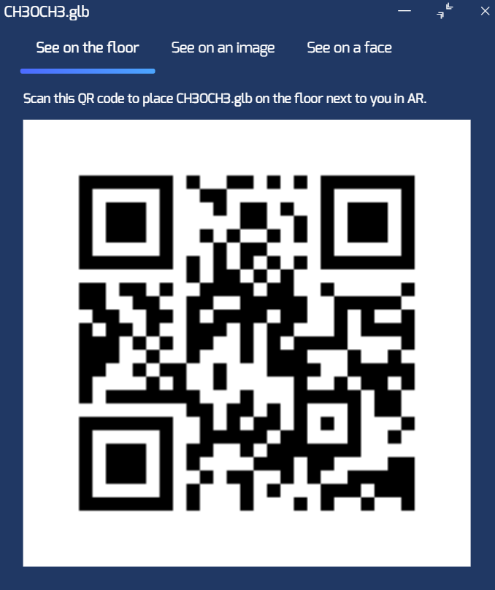
CURRENT STATUS:
CH30CH3
DIMETHYL-ETHER

Slide 11
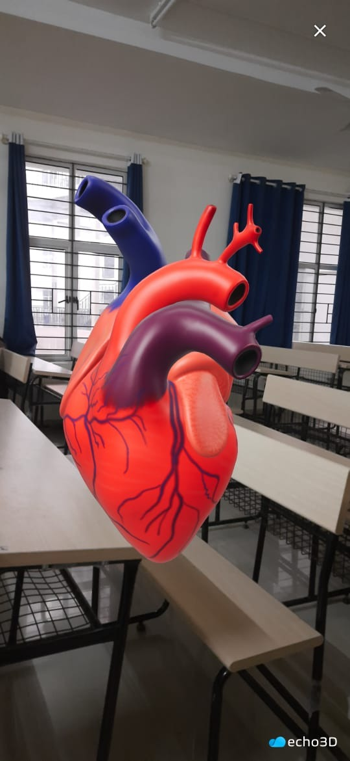
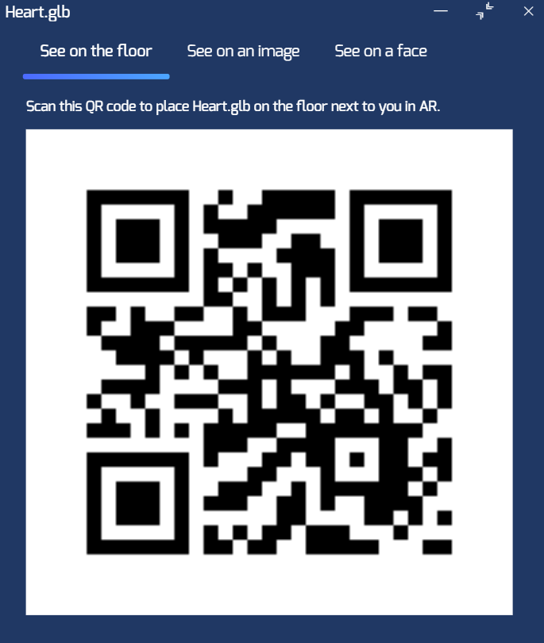
CURRENT STATUS:
HEART

Slide 12
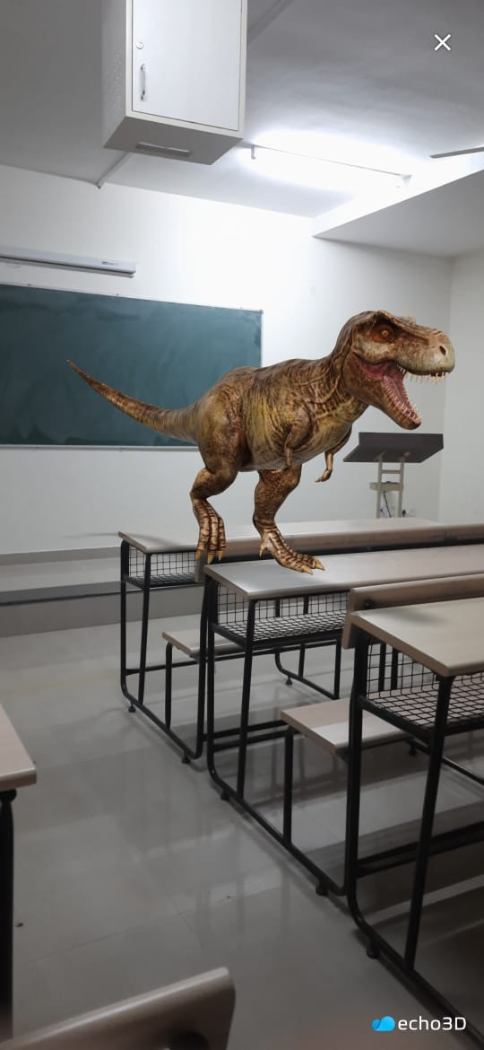
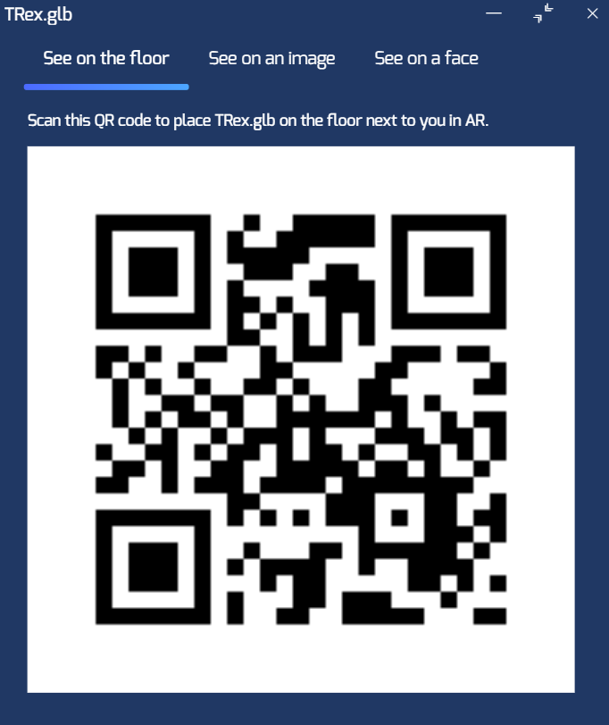
CURRENT STATUS:
T-REX

Slide 13
CURRENT STATUS:
On echo3D, we've developed several 3D modules with a unique QR code for each image.
We're attempting to develop something similar, where each 3D module's target image is set.
We aim to model the 3D modules from scratch using blender and Paint 3D because many of them were imported from various libraries.
We're also attempting to make the same software with Unity 3D.

Slide 14


OUR TEAM
BINAYAKANTA SENAPATI
DIKSHITHA AV
R19CS067
CSE
5 SEM
R19CS095
CSE
5 SEM

Slide 15


OUR TEAM
HEBA MARYAM
HIMASHREE M
R19CS122
CSE
5 SEM
R19CS125
CSE
5 SEM

Slide 16
THANK YOU!!

